Slide 1
Software Engineering
BCSC0009
Rajesh Kumar Tripathi
Assistant Professor
Dept. of Computer Engineering & Applications, IET,
GLA University, Mathura

Slide 2
Module II
14 | II | Function-Oriented Design | Problem Partitioning, Abstraction,
15 |  |  | Top Down and Bottom Up Design.
 |  | Module-Level Concepts | Coupling, Cohesion
16 |  |  | Design Notation and Specification-Structure Charts
17 |  |  | Structured Design Methodology - Data Flow Diagram.
18
 |  | OO Analysis and OO Design | OO Concepts, Introduction to UML Design Patterns
19
 |  |  | Sequence Diagram
20
 |  |  | Activity Diagram, State Chart Diagram
21
 |  | Coding | Coding Process
22
 |  |  | Verification - Code Inspections, Static Analysis
23
24 |  |  | Metrics- Size Measures:
25 |  |  | Halsted measures like n,N,V,L,D

Slide 3
Software Design
Software Metrics: What and Why ?
How to measure the size of a software?
How much will it cost to develop a software?
How many bugs can we expect?
When can we stop testing?
When can we release the software?

Slide 4
Software Metrics
What is the complexity of a module?
What is the module strength and coupling?
What is the reliability at the time of release?
Which test technique is more effective?
Are we testing hard or are we testing smart?
Do we have a strong program or a week test suite?

Slide 5
Software Metrics
Pressman explained as “A measure provides a quantitative
indication of the extent, amount, dimension, capacity, or size of
some attribute of the product or process”.
Measurement is the act of determine a measure.
The metric is a quantitative measure of the degree to which a system, component, or process possesses a given attribute.
Fenton defined measurement as “it is the process by which numbers or symbols are assigned to attributes of entities in the real world in such a way as to describe them according to clearly defined rules”.

Slide 6
Software Metrics
Definition
Software metrics can be defined as:
“The continuous application of measurement based
techniques to the software development process and its
products to supply meaningful and timely management
information, together with the use of those techniques to
improve that process and its products”.

Slide 7
Software Metrics
Categories of Metrics
Product metrics: describe the characteristics of the product such as size, complexity, design features, performance, efficiency, reliability, portability, etc.
Process metrics: describe the effectiveness and quality of the processes that produce the software product. Examples are:
effort required in the process
time to produce the product
effectiveness of defect removal during development
number of defects found during testing
maturity of the process

Slide 8
Software Metrics
Project metrics: describe the project characteristics and execution. Examples are :
number of software developers
staffing pattern over the life cycle of the software
cost and schedule
productivity

Slide 9
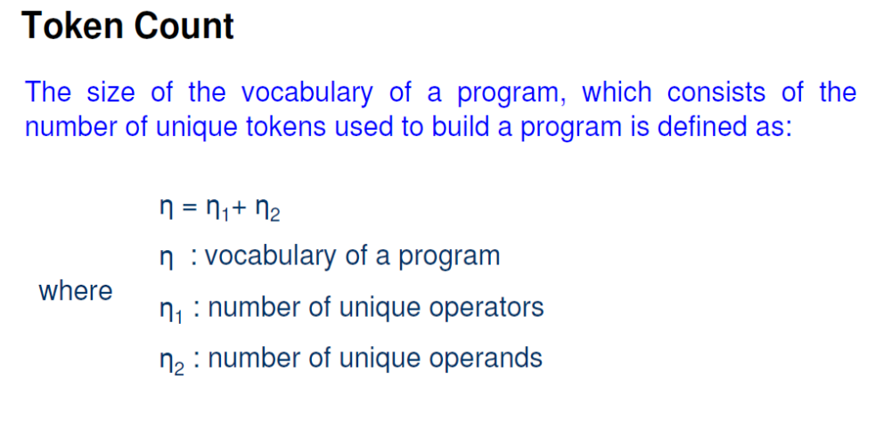
Software metrics

Slide 10
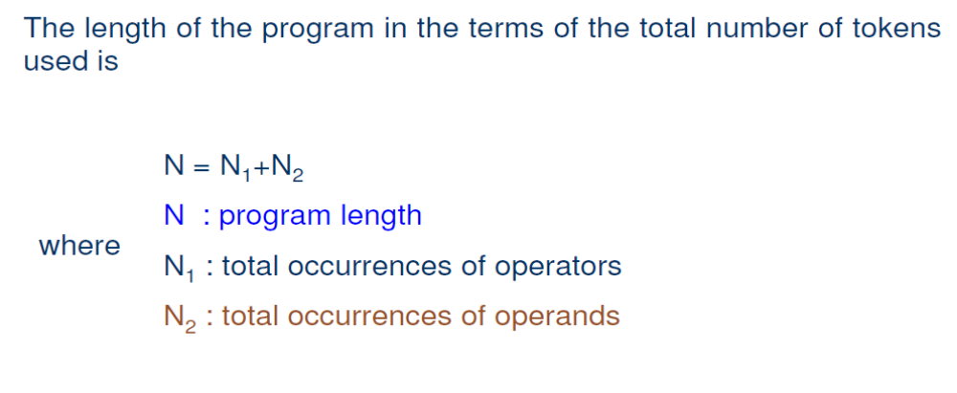
Software metrics

Slide 11
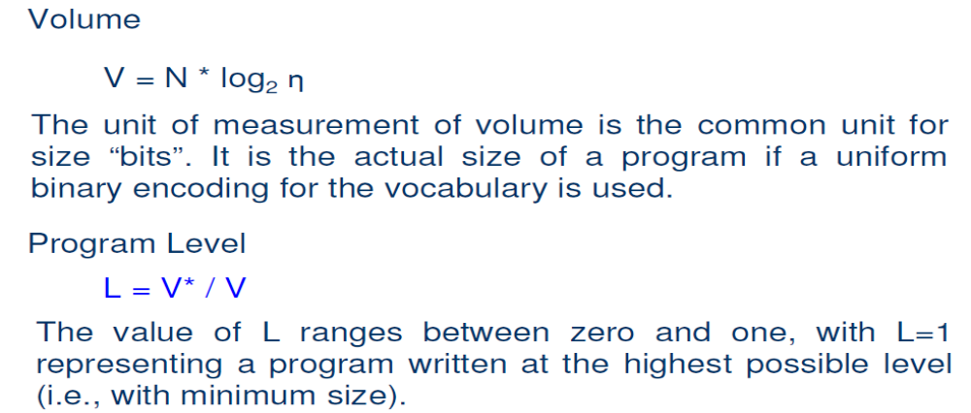
Software metrics

Slide 12
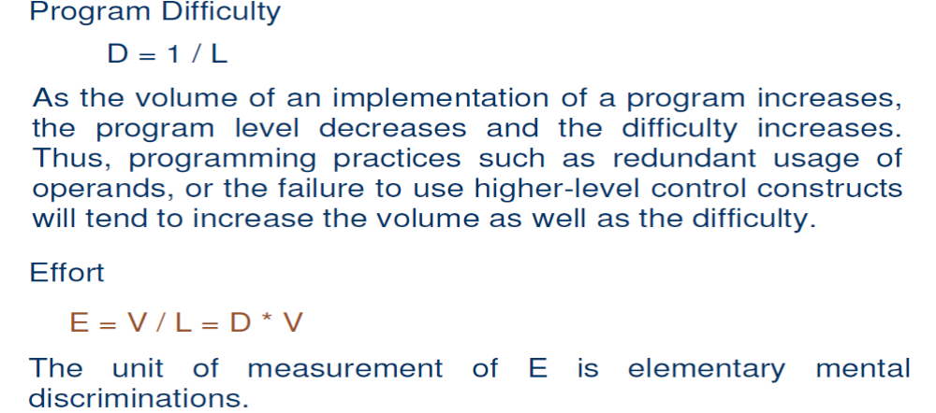
Software metrics

Slide 13
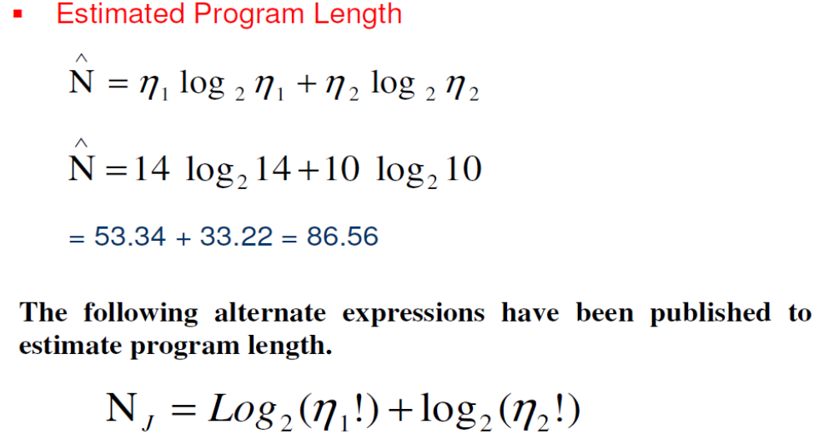
Software metrics

Slide 14
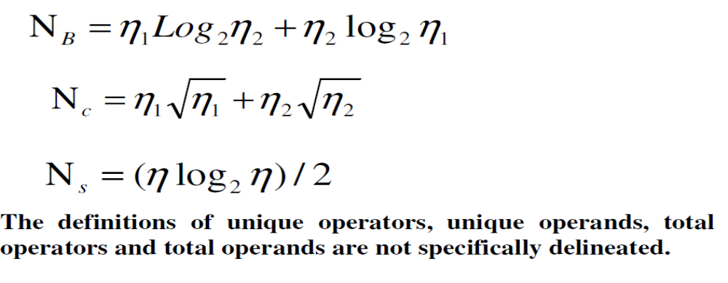
Software metrics

Slide 15
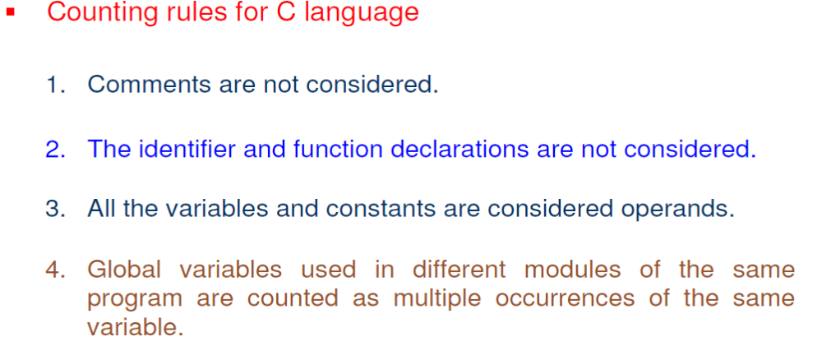
Software metrics

Slide 16
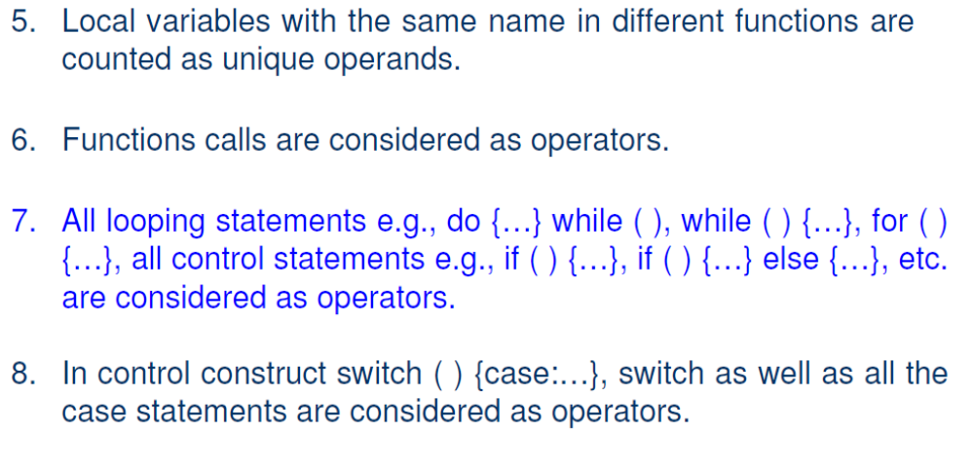
Software metrics

Slide 17
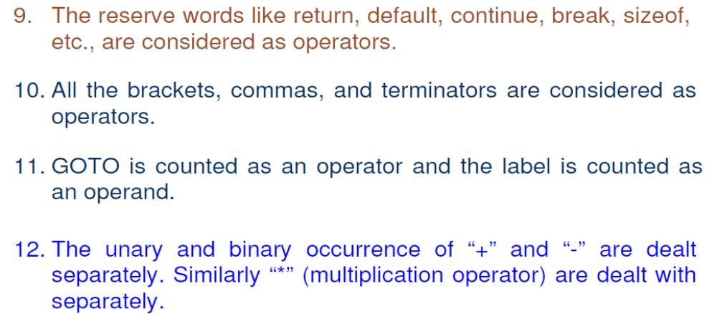
Software metrics

Slide 18
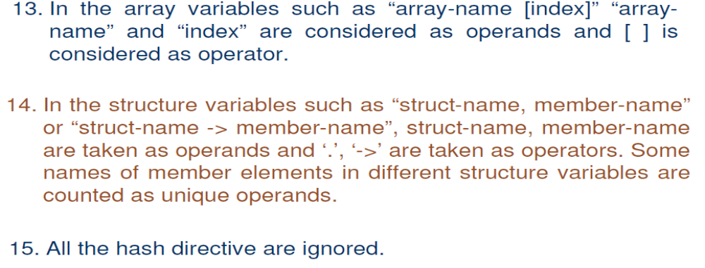
Software metrics

Slide 19
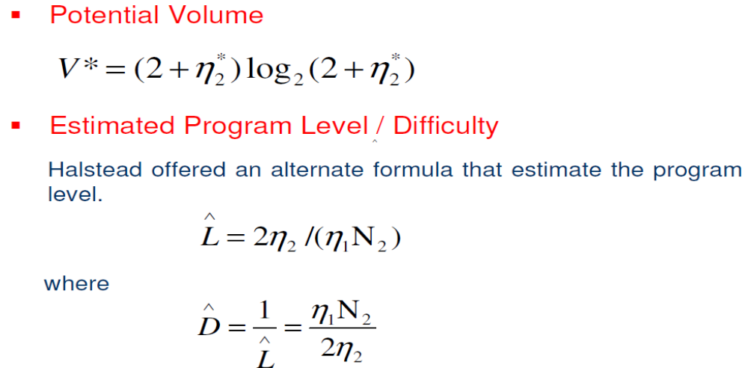
Software metrics

Slide 20
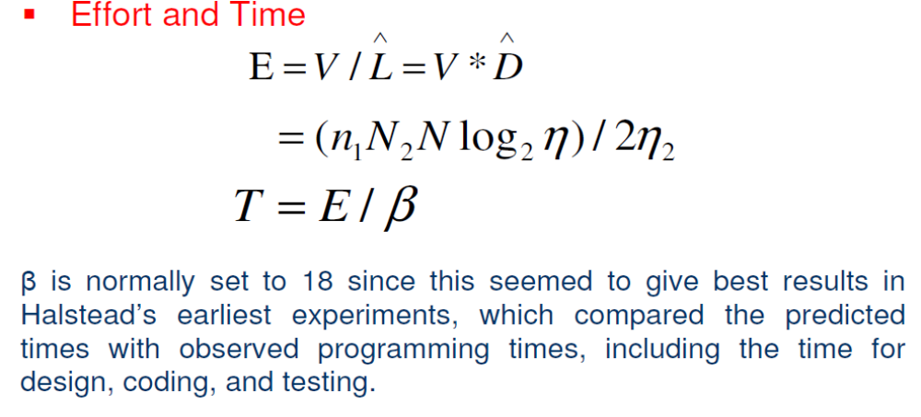
Software metrics

Slide 21
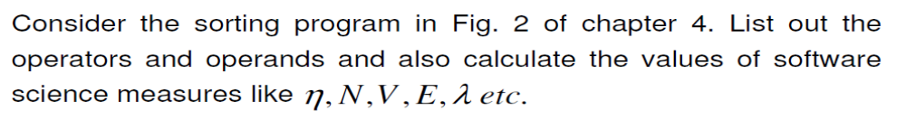
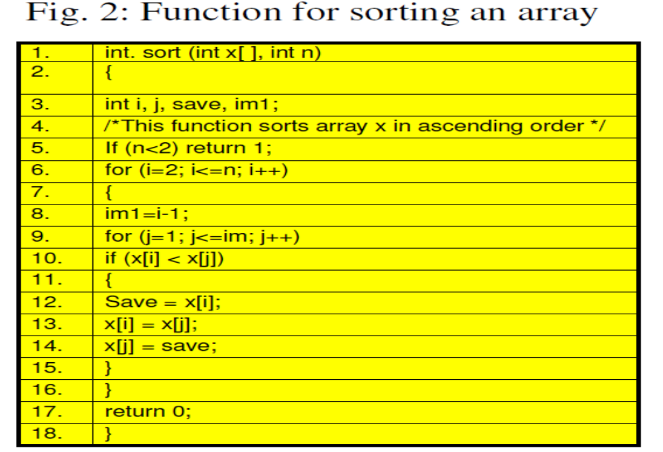
Software Design

Slide 22
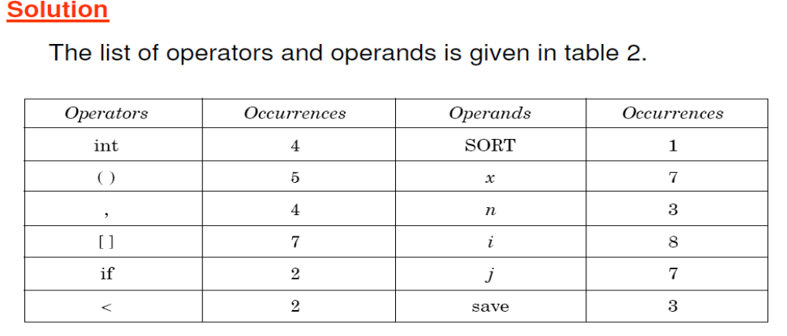
Software Design

Slide 23
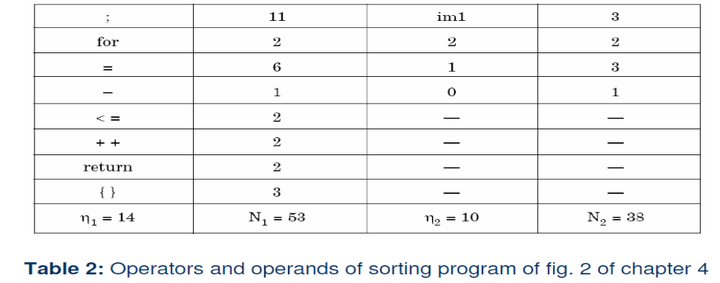
Software Design

Slide 24
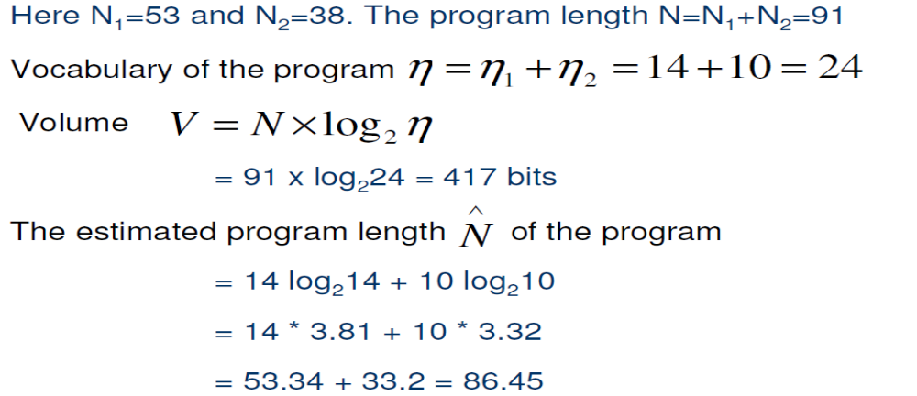
Software Design

Slide 25
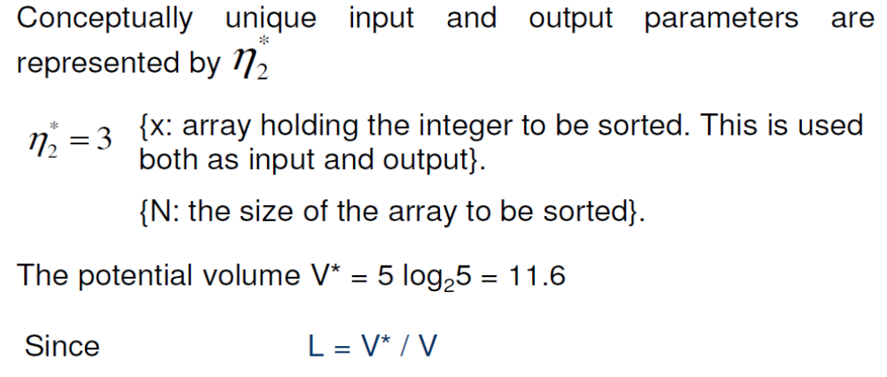
Software Design

Slide 26
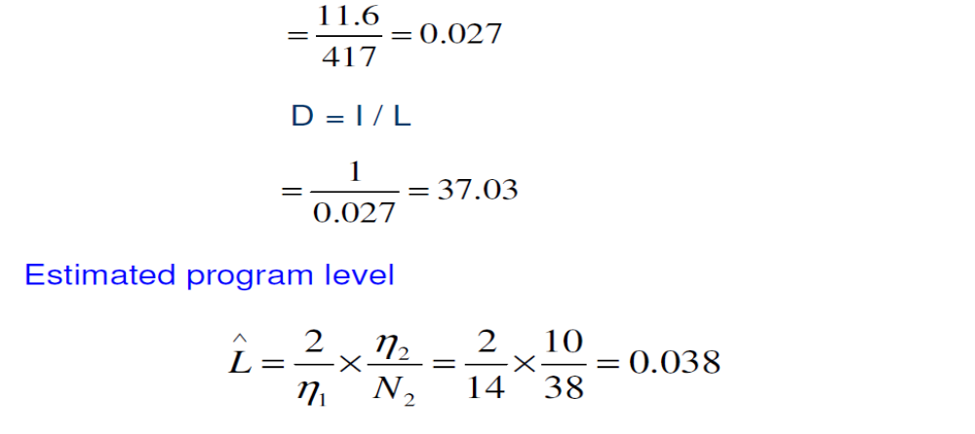
Software Design

Slide 27
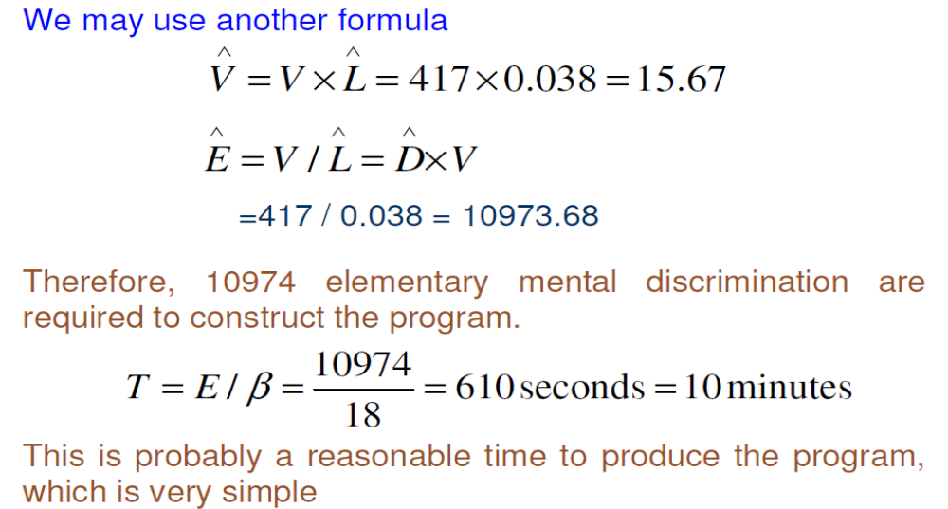
Software Design

Slide 28
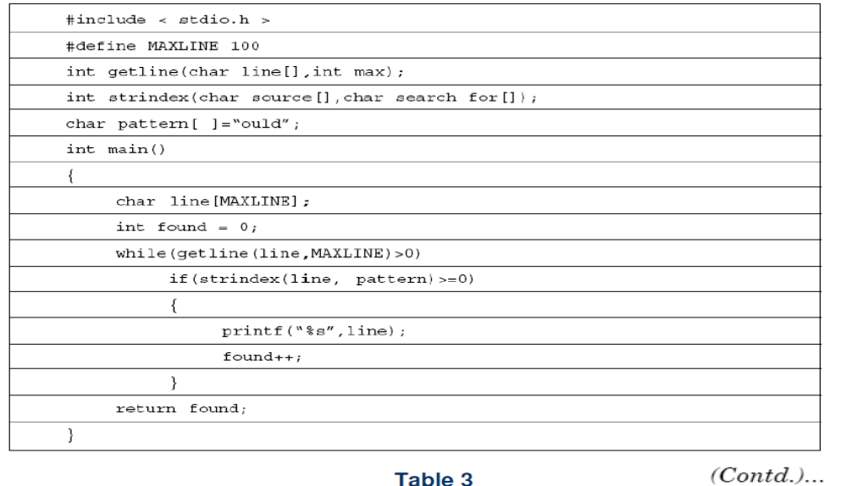
Software Design

Slide 29
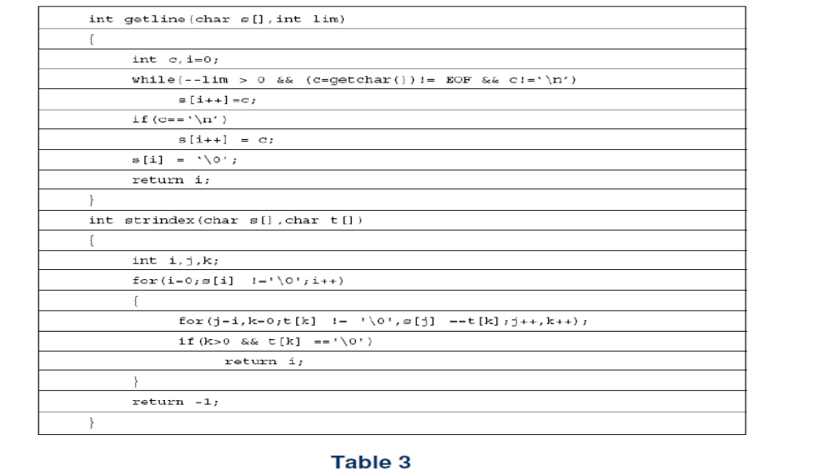
Software Design

Slide 30
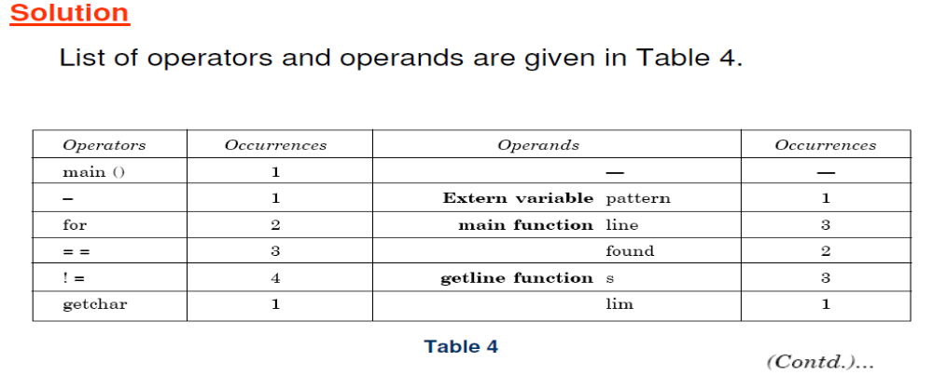
Software Design

Slide 31
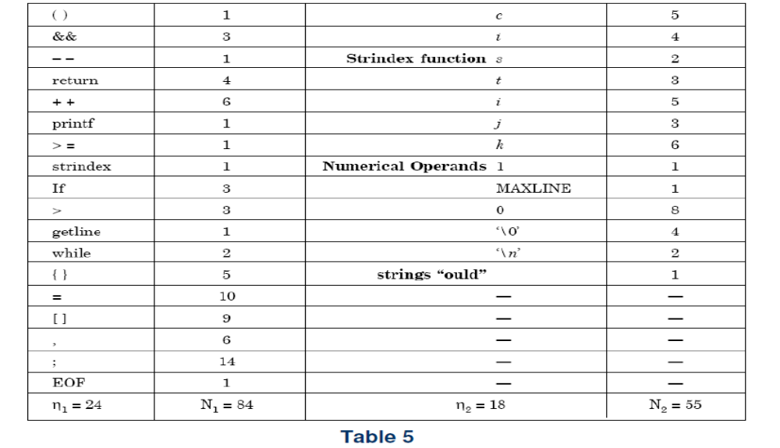
Software Design

Slide 32
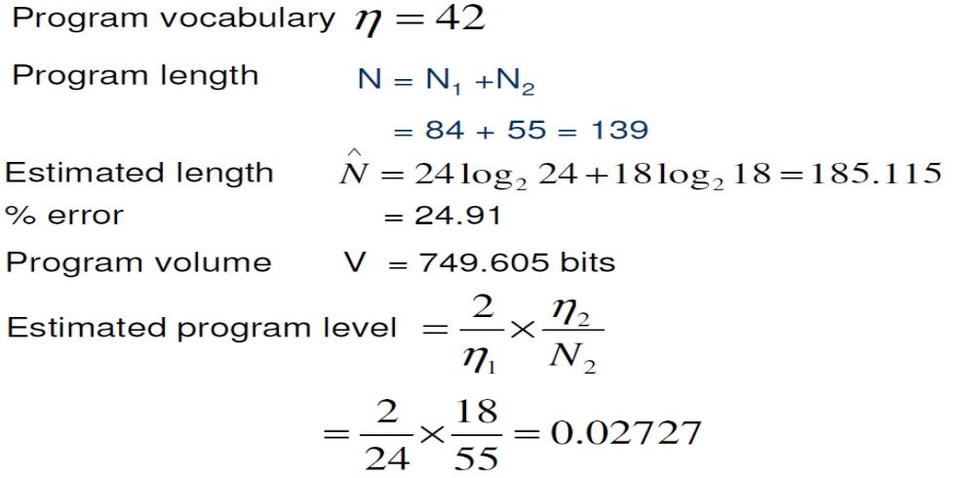
Software Design

Slide 33
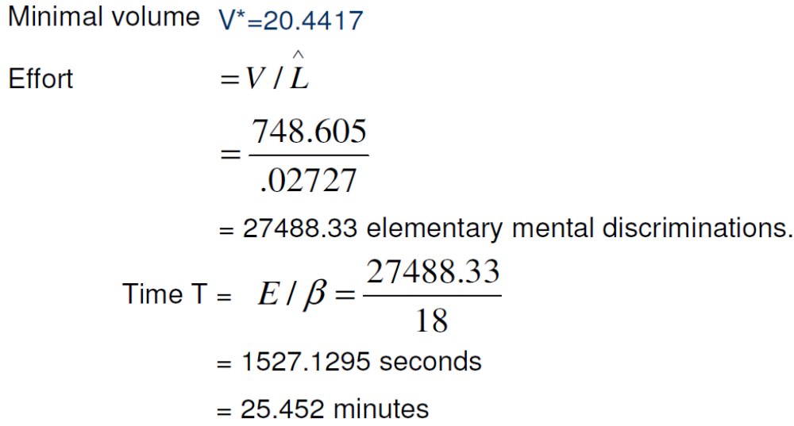
Software Design

Slide 34
Thank You

